Slide 1
Hand Gesture Recognition using Python and OpenCV

Slide 2



Slide 3
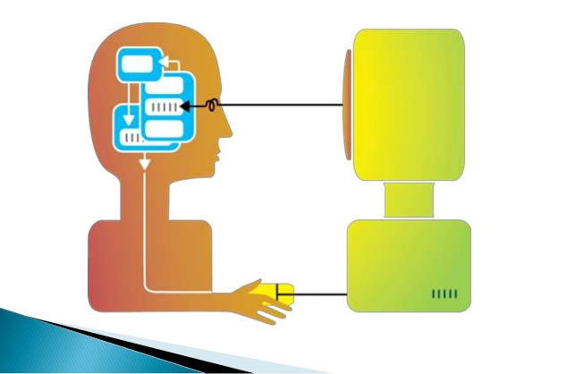
Human-Computer Interaction (HCI)

Slide 4
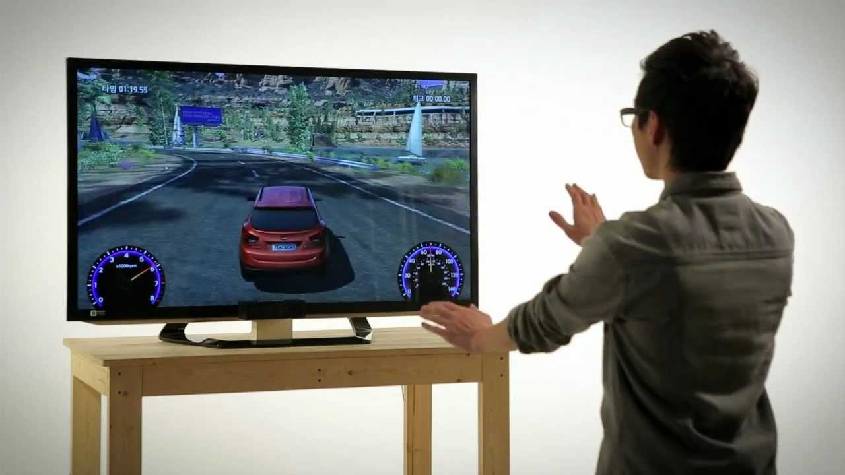
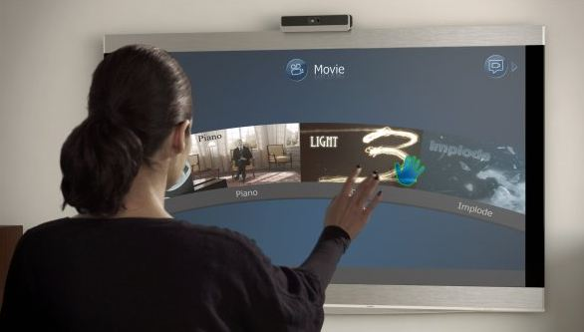

Slide 5
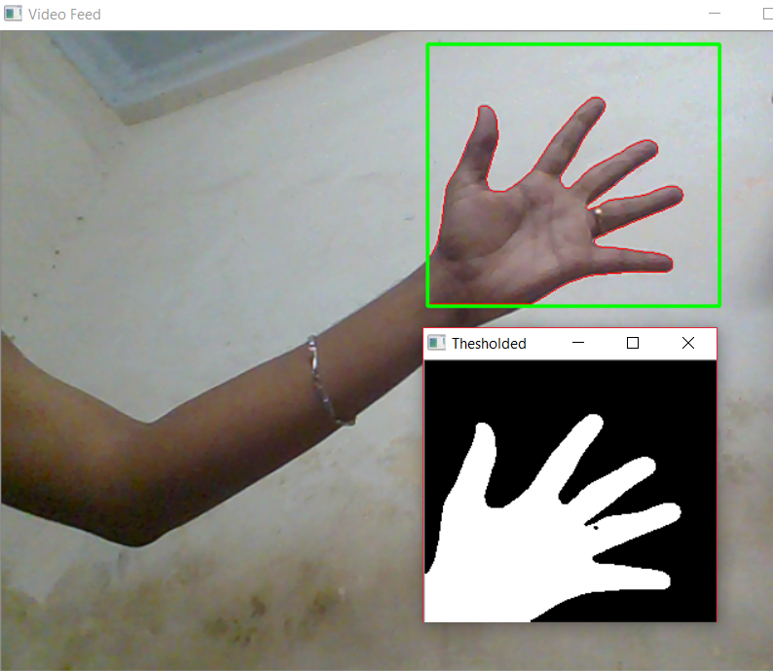
Thresholding

Slide 6
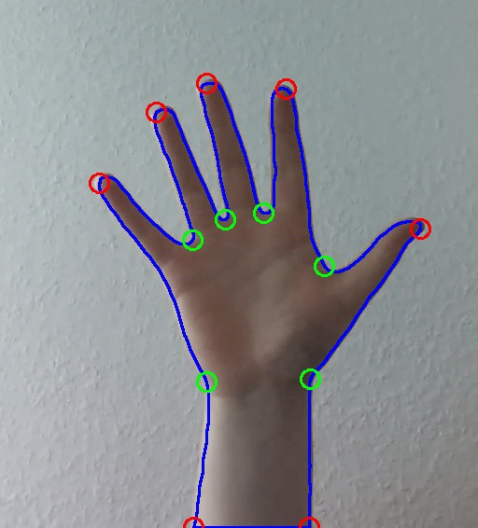
RGB – Red Green Blue Image

